Slide 1
A Short History of Freemasonry
Written by Bob Roth

Slide 2
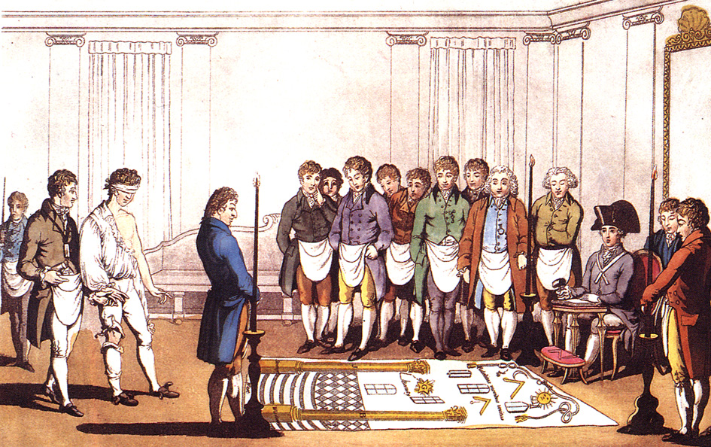
Masonic History

Slide 3
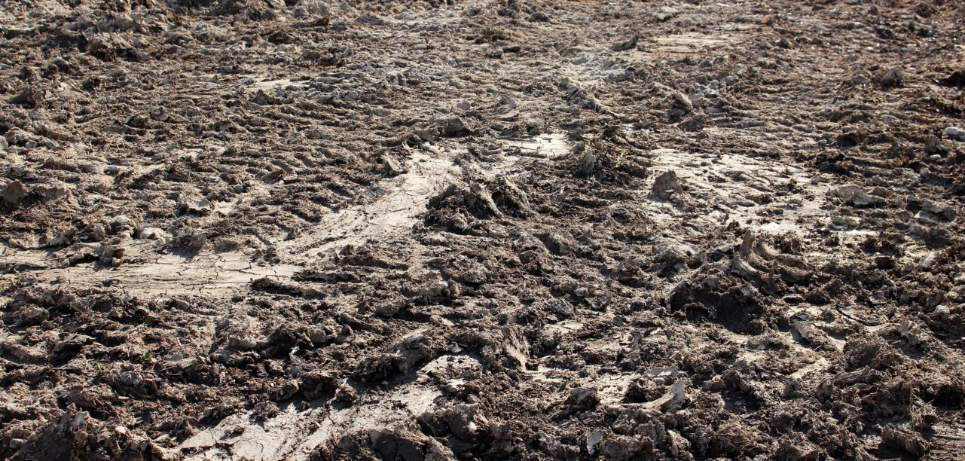
Masonic History is…Muddy

Slide 4
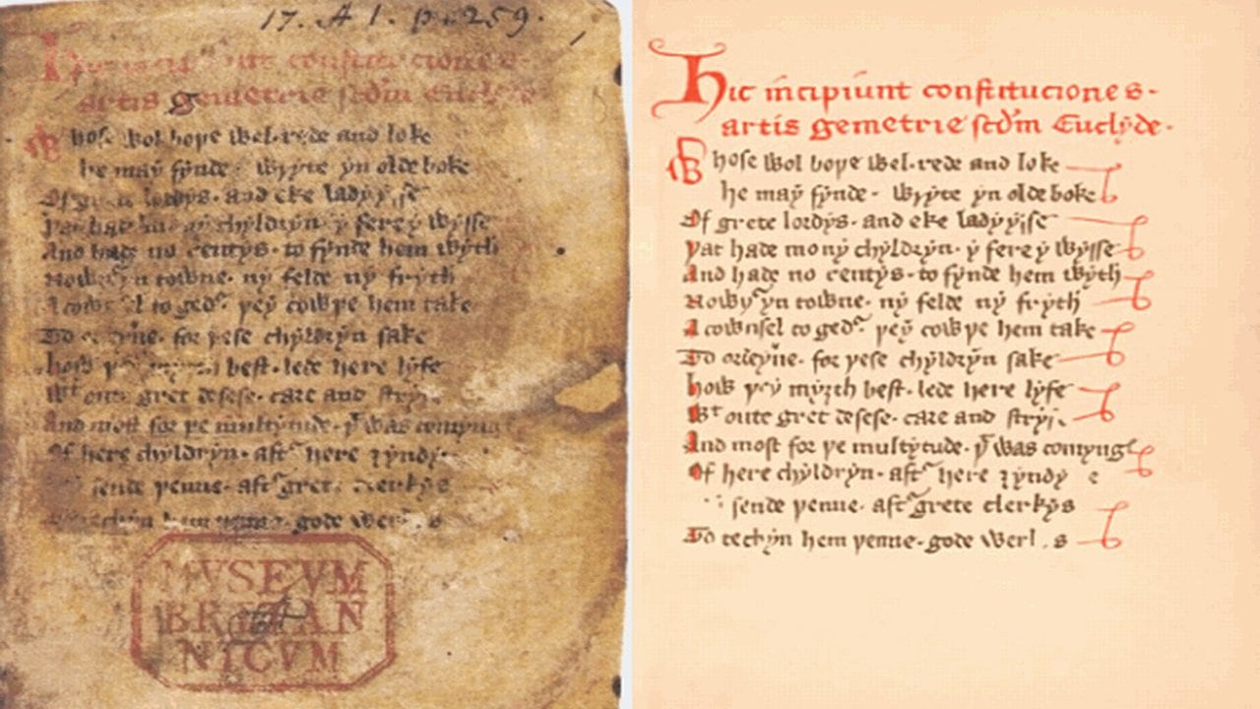

Slide 5
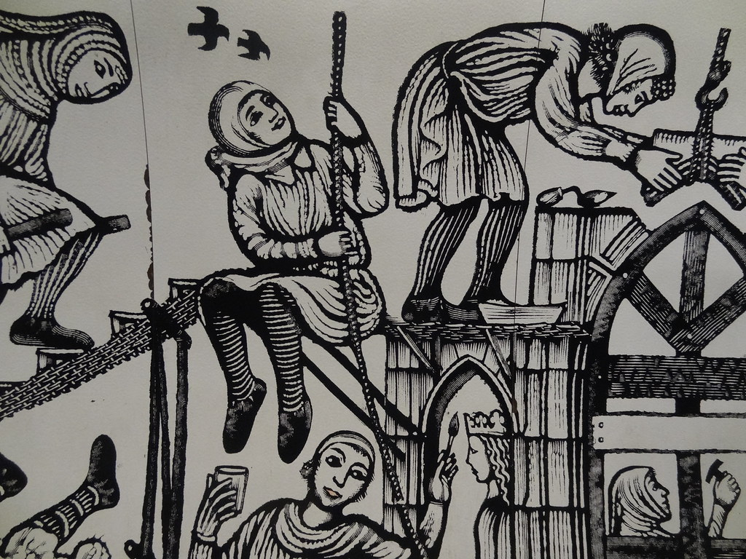
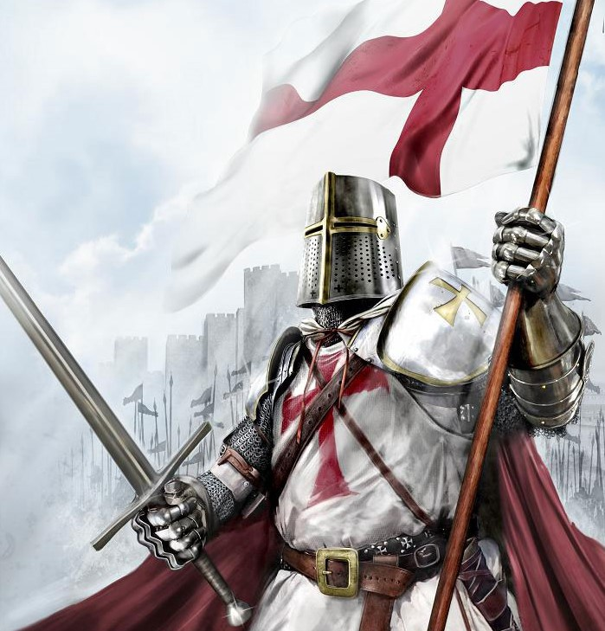
Two Main Theories

Slide 6
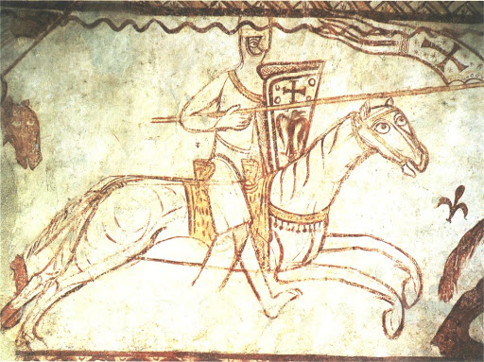
Templar Theory

Slide 7
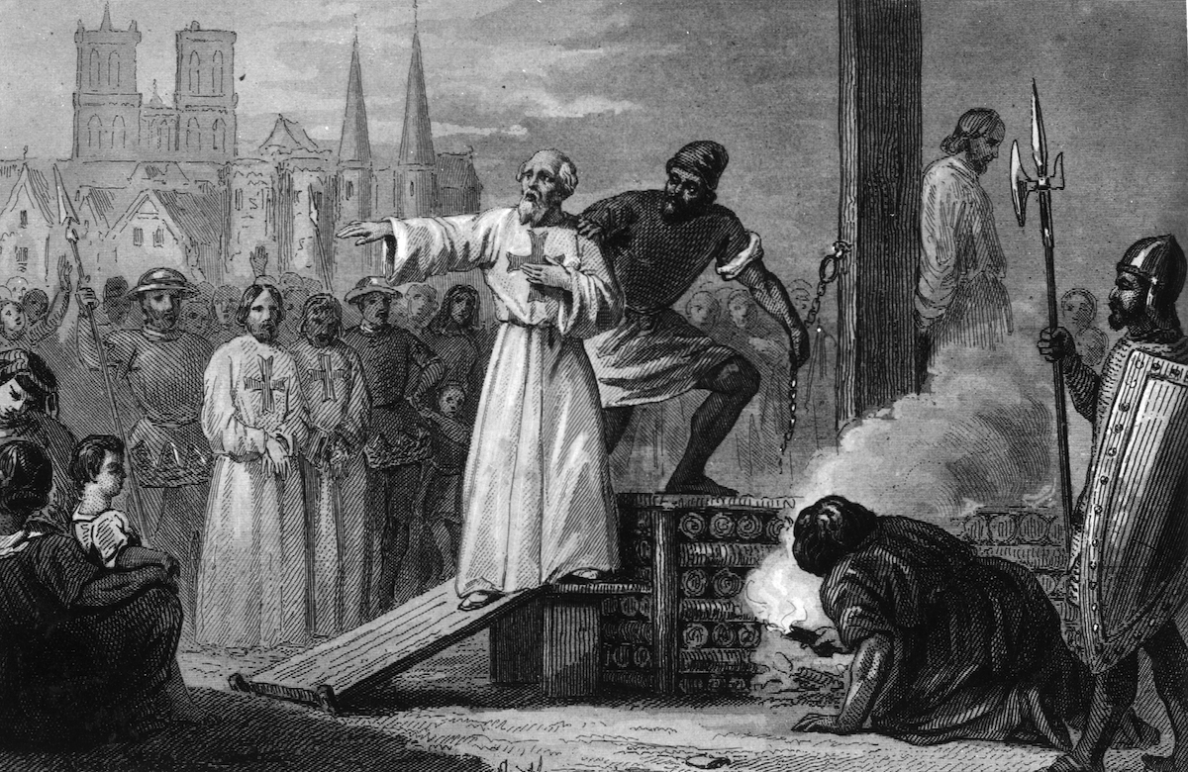

Slide 9
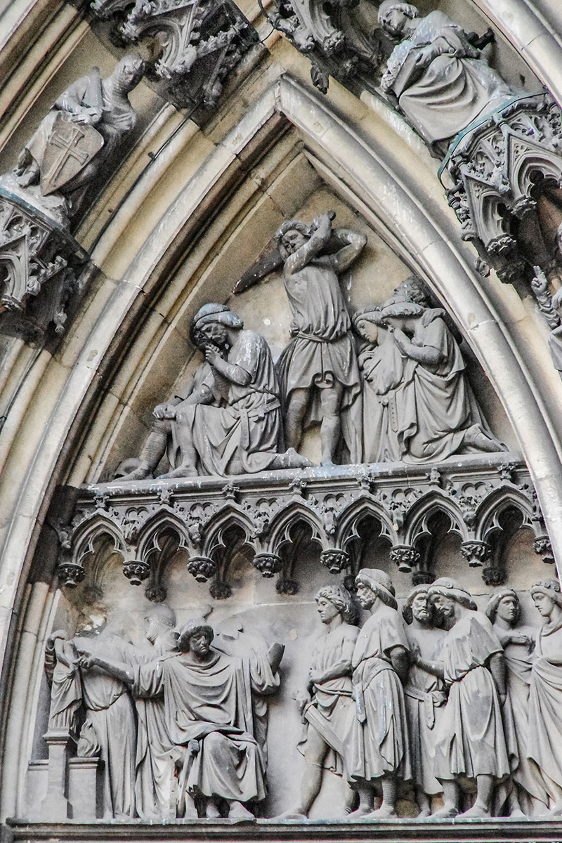
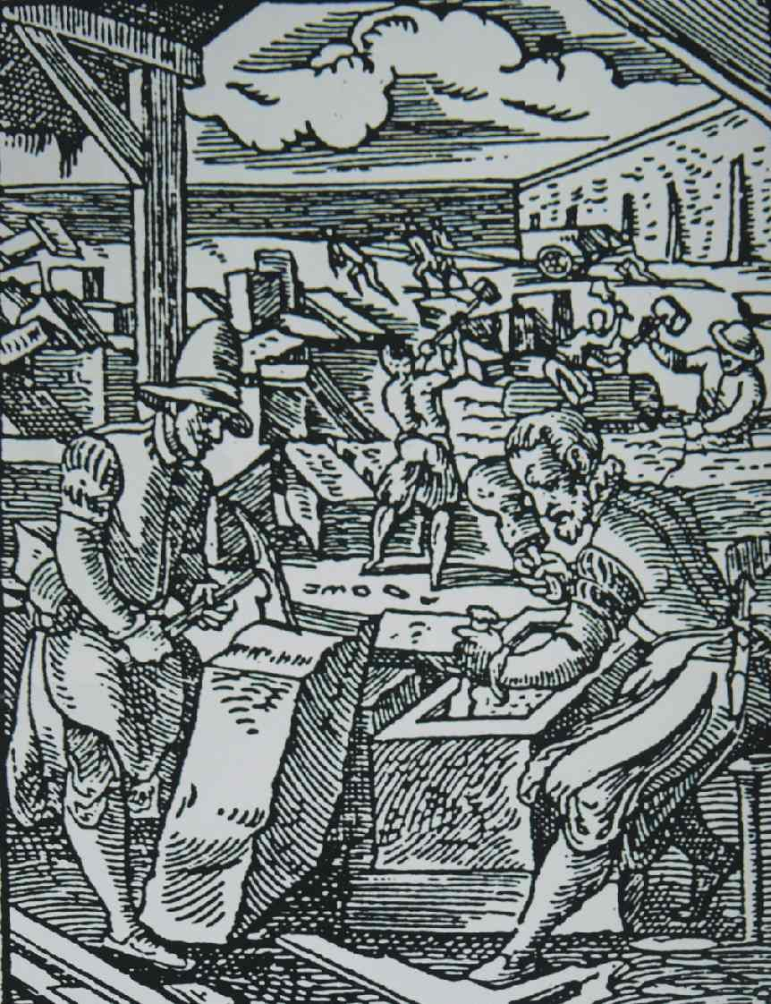
Medieval Stone Masons Theory

Slide 10
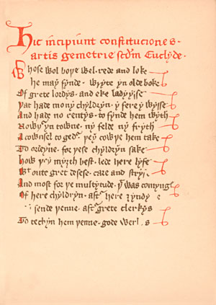
Historical Evidence
(Regius Poem) 1390
Matthew Cooke Manuscript 1450
Regensburg Statutes 1459

Slide 12
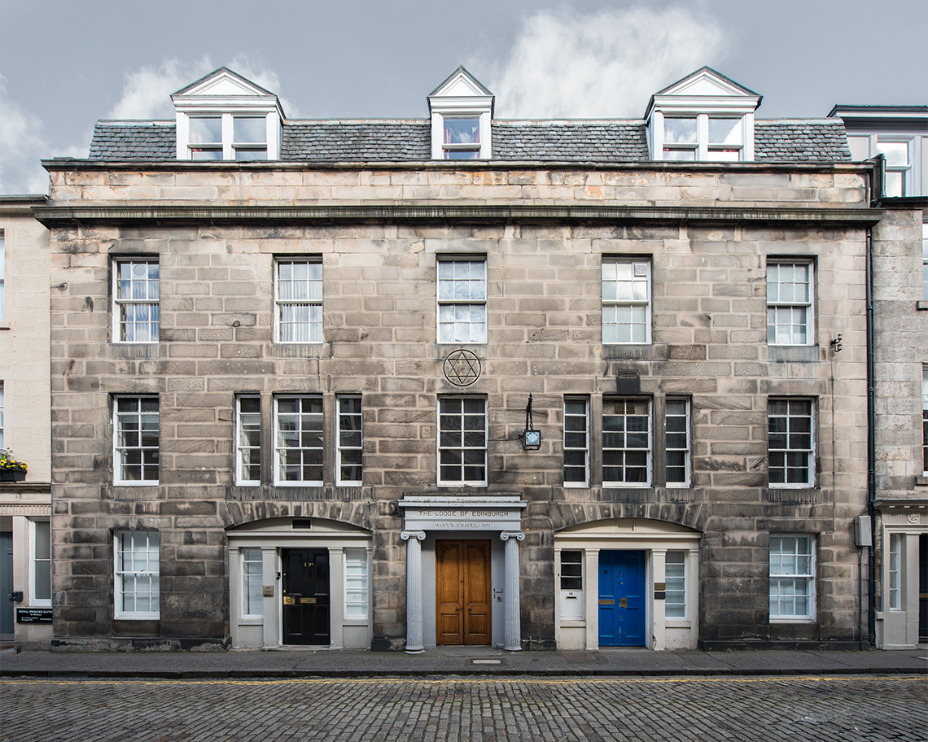
The Lodge of Edinburgh
(Mary's Chapel), No.1, 1599

Slide 13
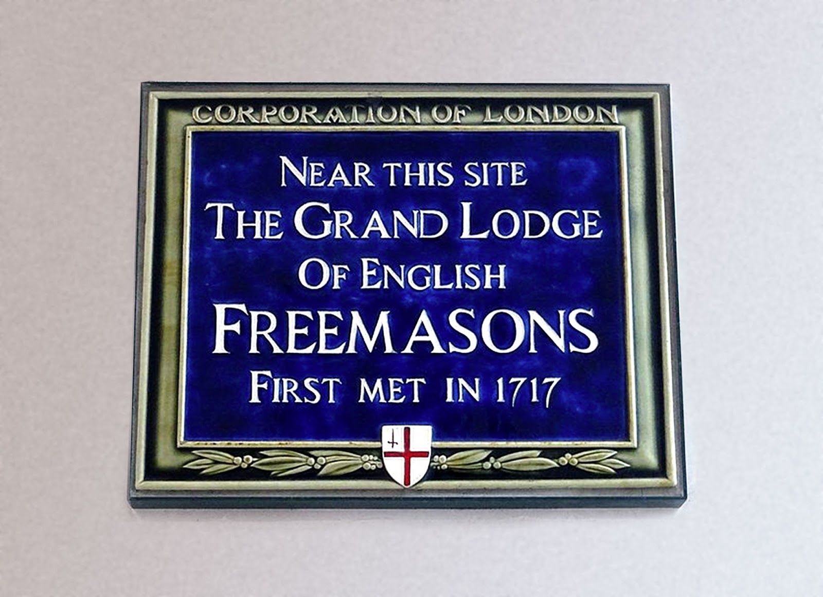
1717 The Lodge Goes Public

Slide 14
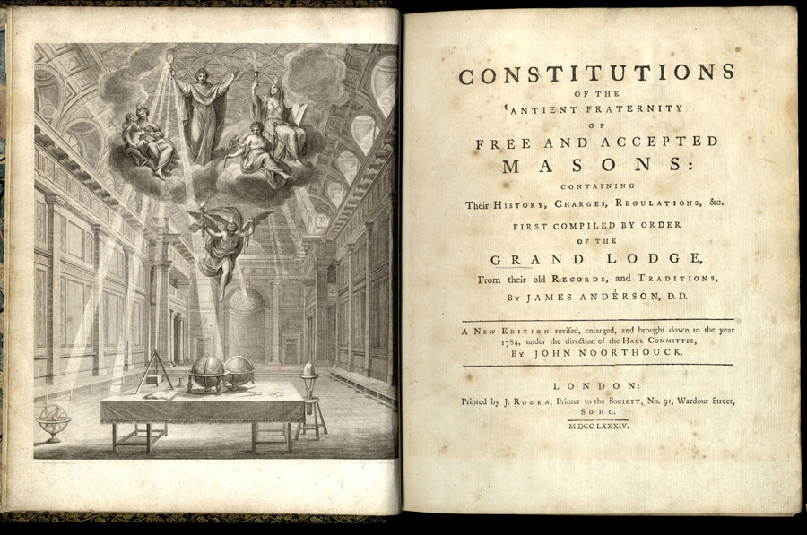

Slide 15
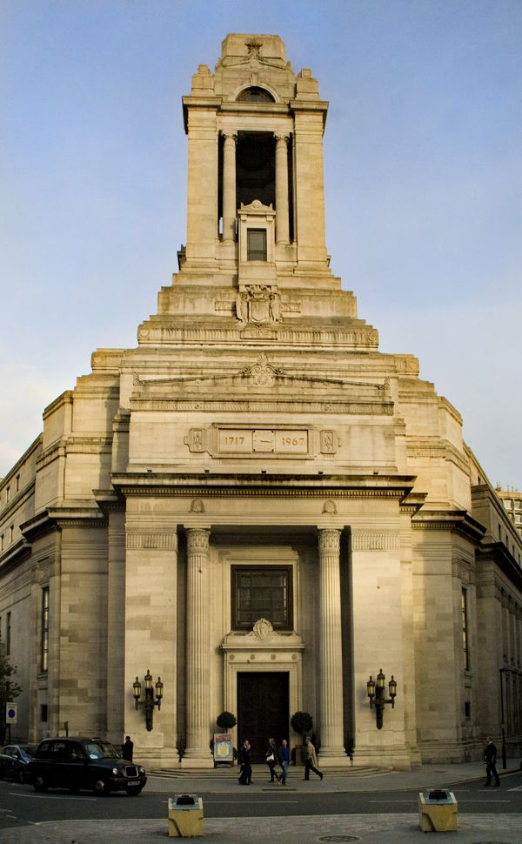

Slide 16
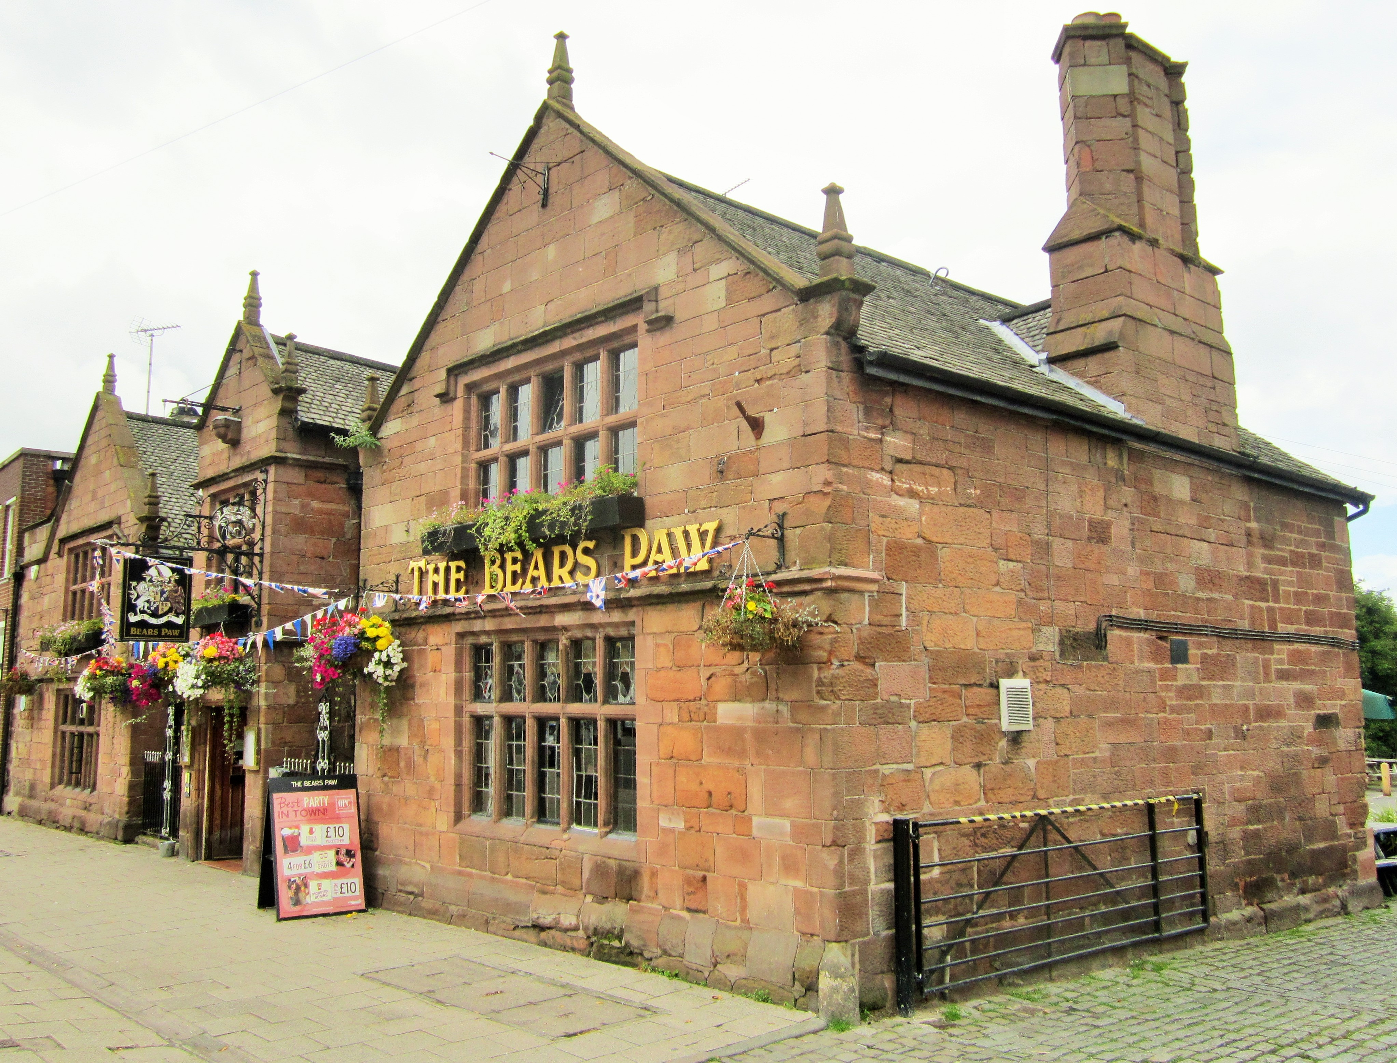
Colonial Lodges

Slide 17
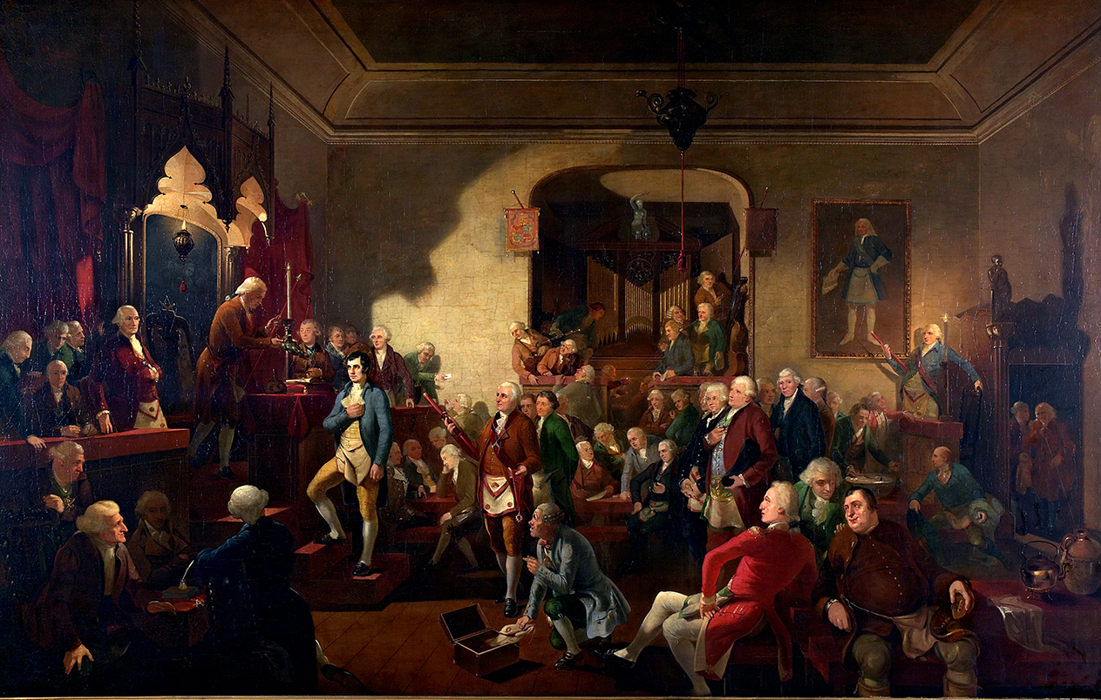

Slide 18
