Slide 1
Masonic Organization
Written by Barry Axelrood
Presented by Chris Luedke

Slide 2
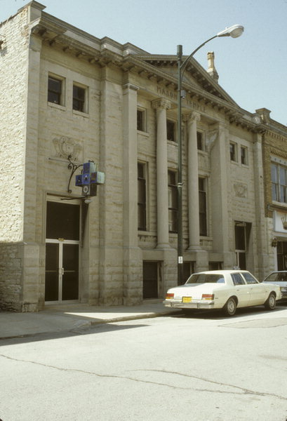

Slide 3
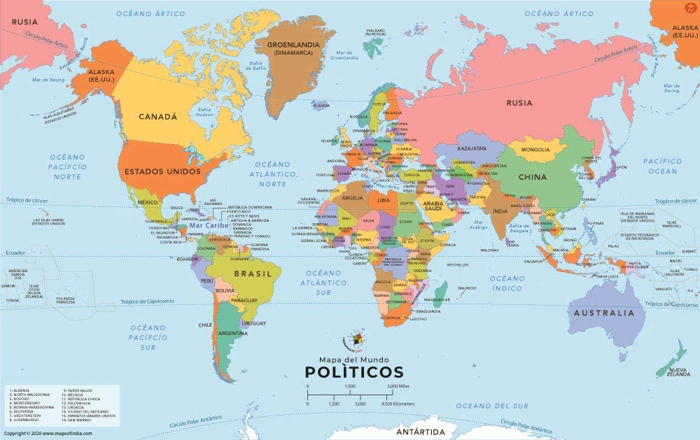

Slide 4
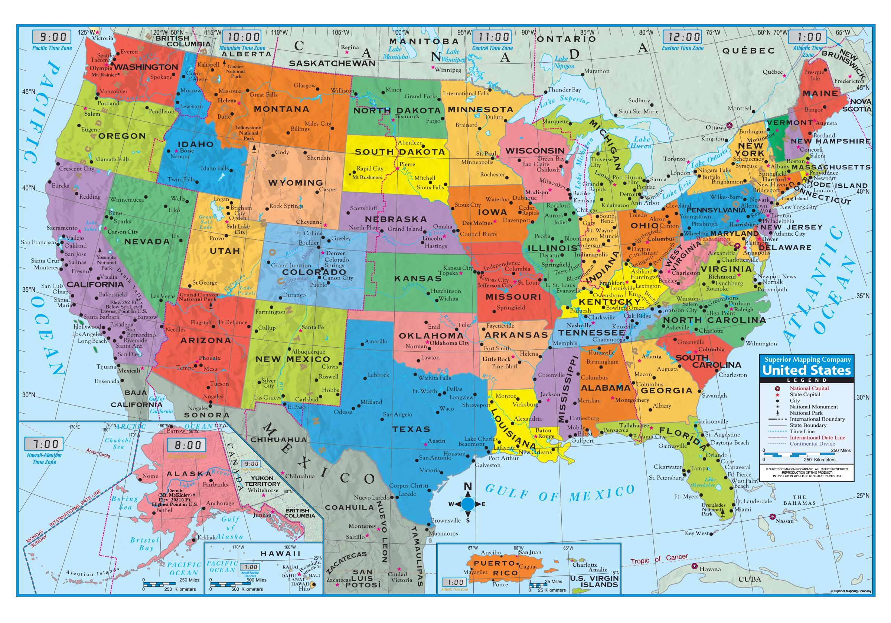

Slide 5
Grand Lodge Structure
Grand Master/ Grand Line
District Deputy
Area Administrators
Your Local Lodge

Slide 6
Grand Lodge Officers
Appointed Officers
Worshipful Grand Chaplain.
Worshipful Grand Lecturer.
Worshipful Senior Grand Deacon.
Worshipful Junior Grand Deacon.
Worshipful Senior Grand Steward.
Worshipful Junior Grand Steward.
Worshipful Grand Marshal.
Worshipful Grand Orator.
Worshipful Grand Tiler.
Worshipful District Deputies.
Elected Officers
Most Worshipful Grand Master.
Right Worshipful Deputy Grand Master.
Right Worshipful Senior Grand Warden.
Right Worshipful Junior Grand Warden.
Right Worshipful Grand Treasurer.
Right Worshipful Grand Secretary.

Slide 7
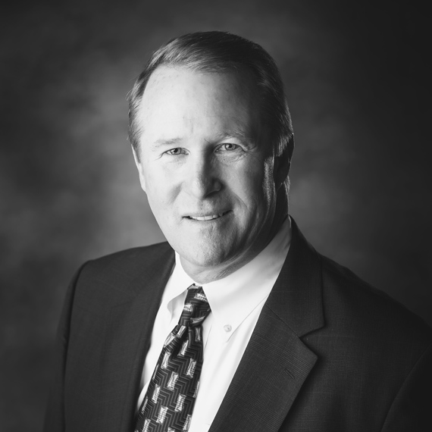
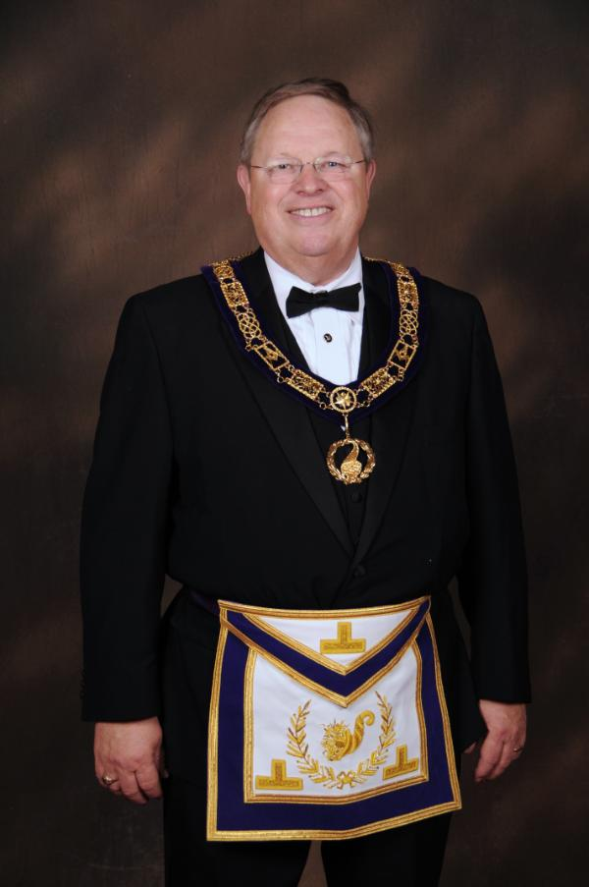
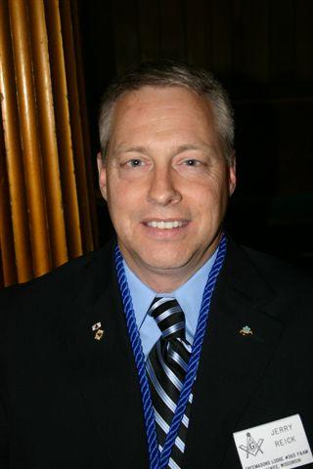
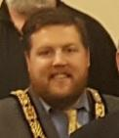
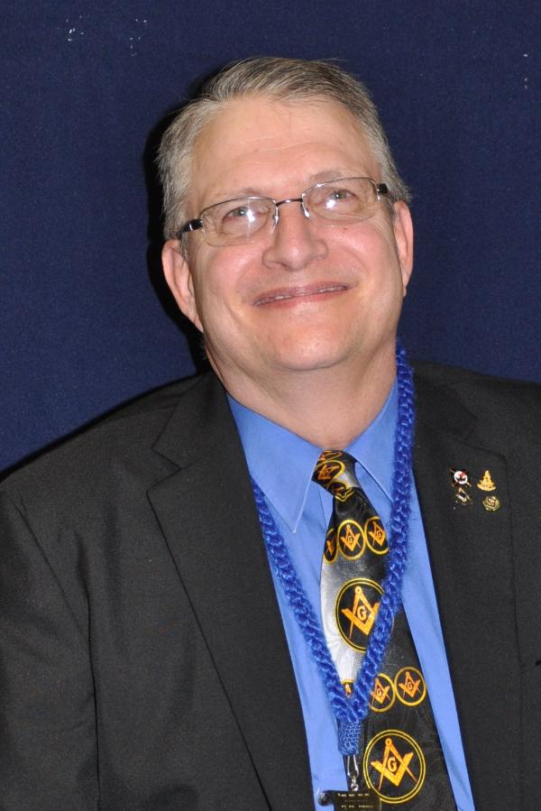
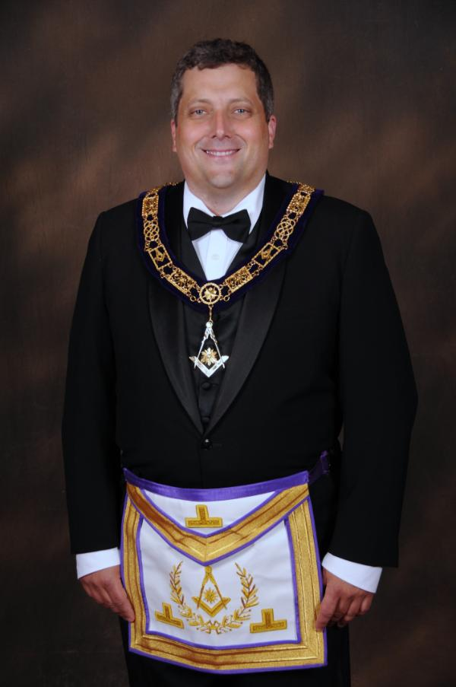
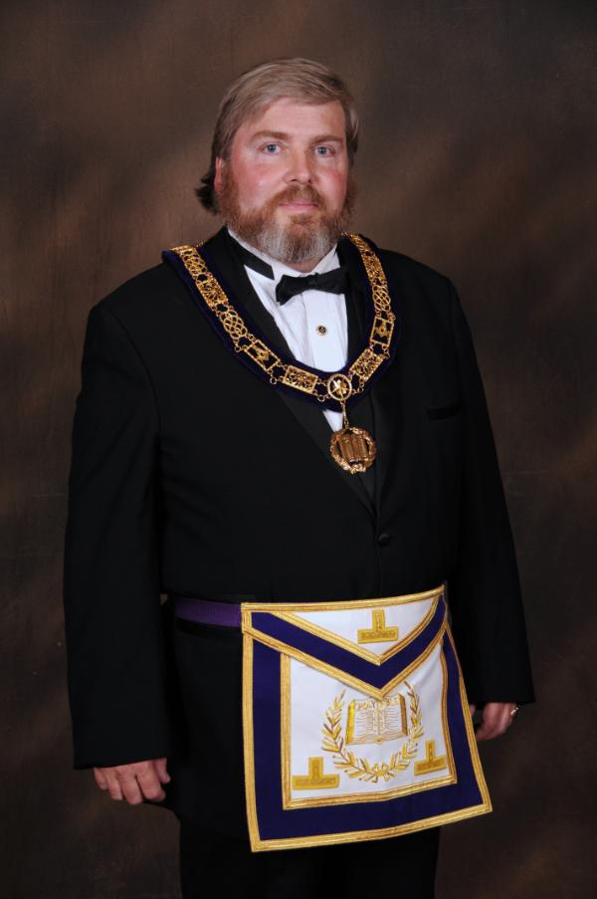
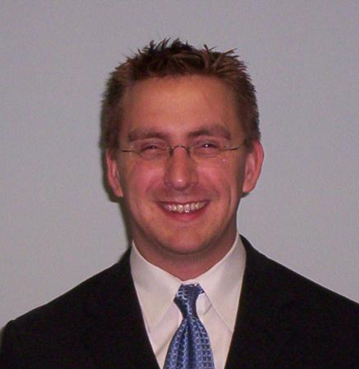
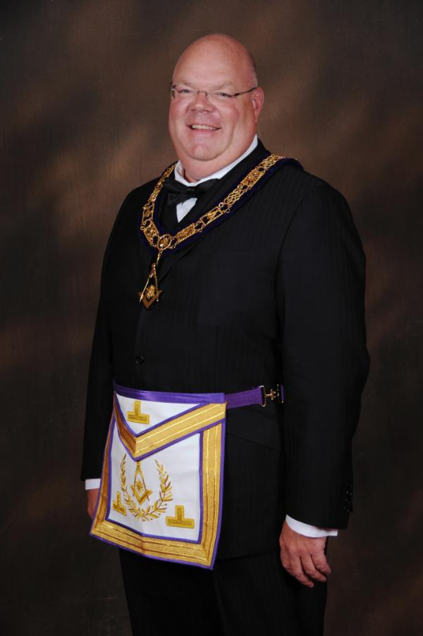

Slide 8
Districts

Slide 9
Areas
2
v
1
3

Slide 10
District Team
District Deputy
District Lecturer
Area Administrator
Area Administrator
Area Administrator

Slide 11
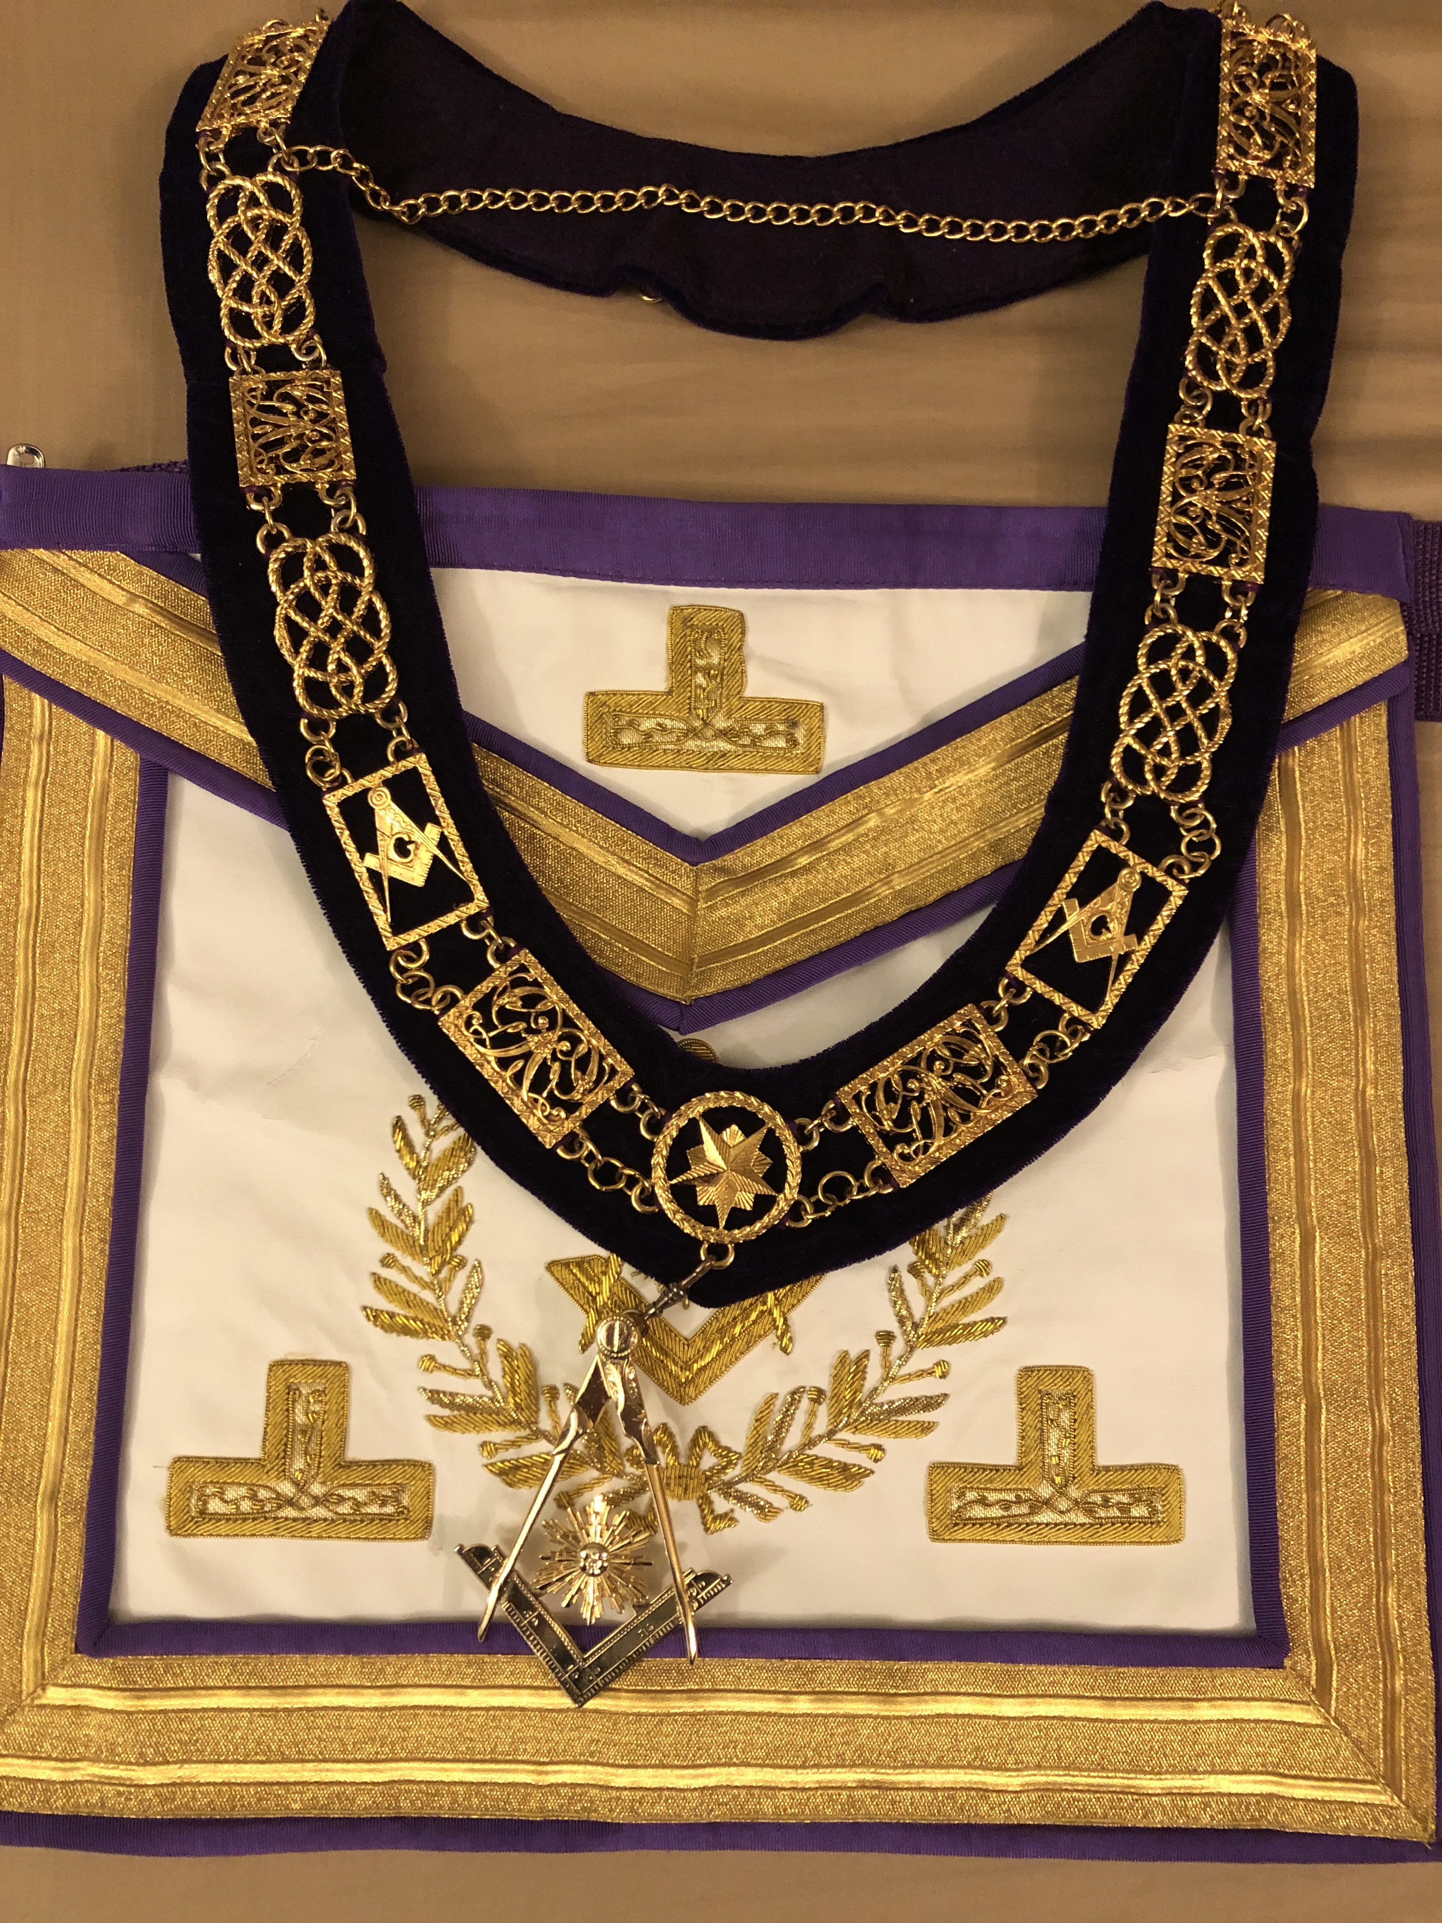
District Deputy

Slide 12
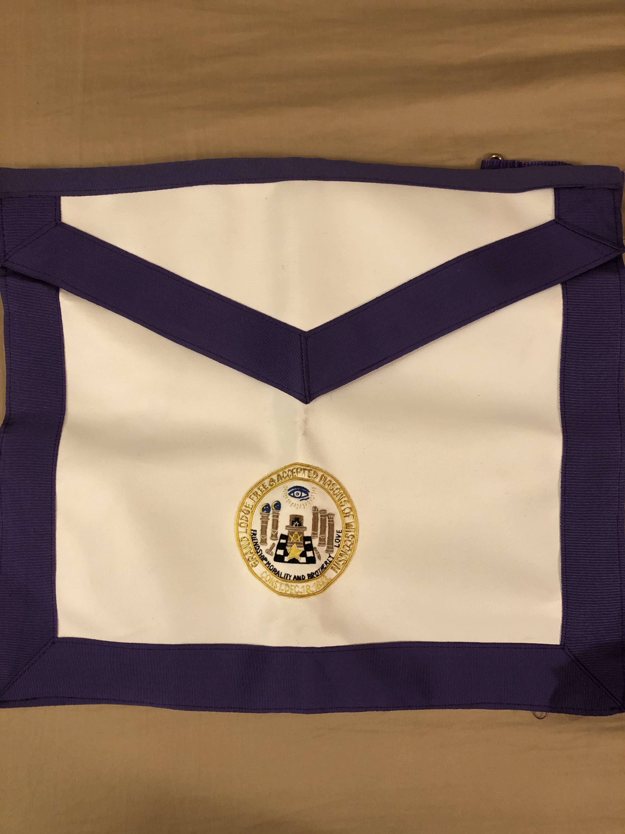
Area Administrator

Slide 13
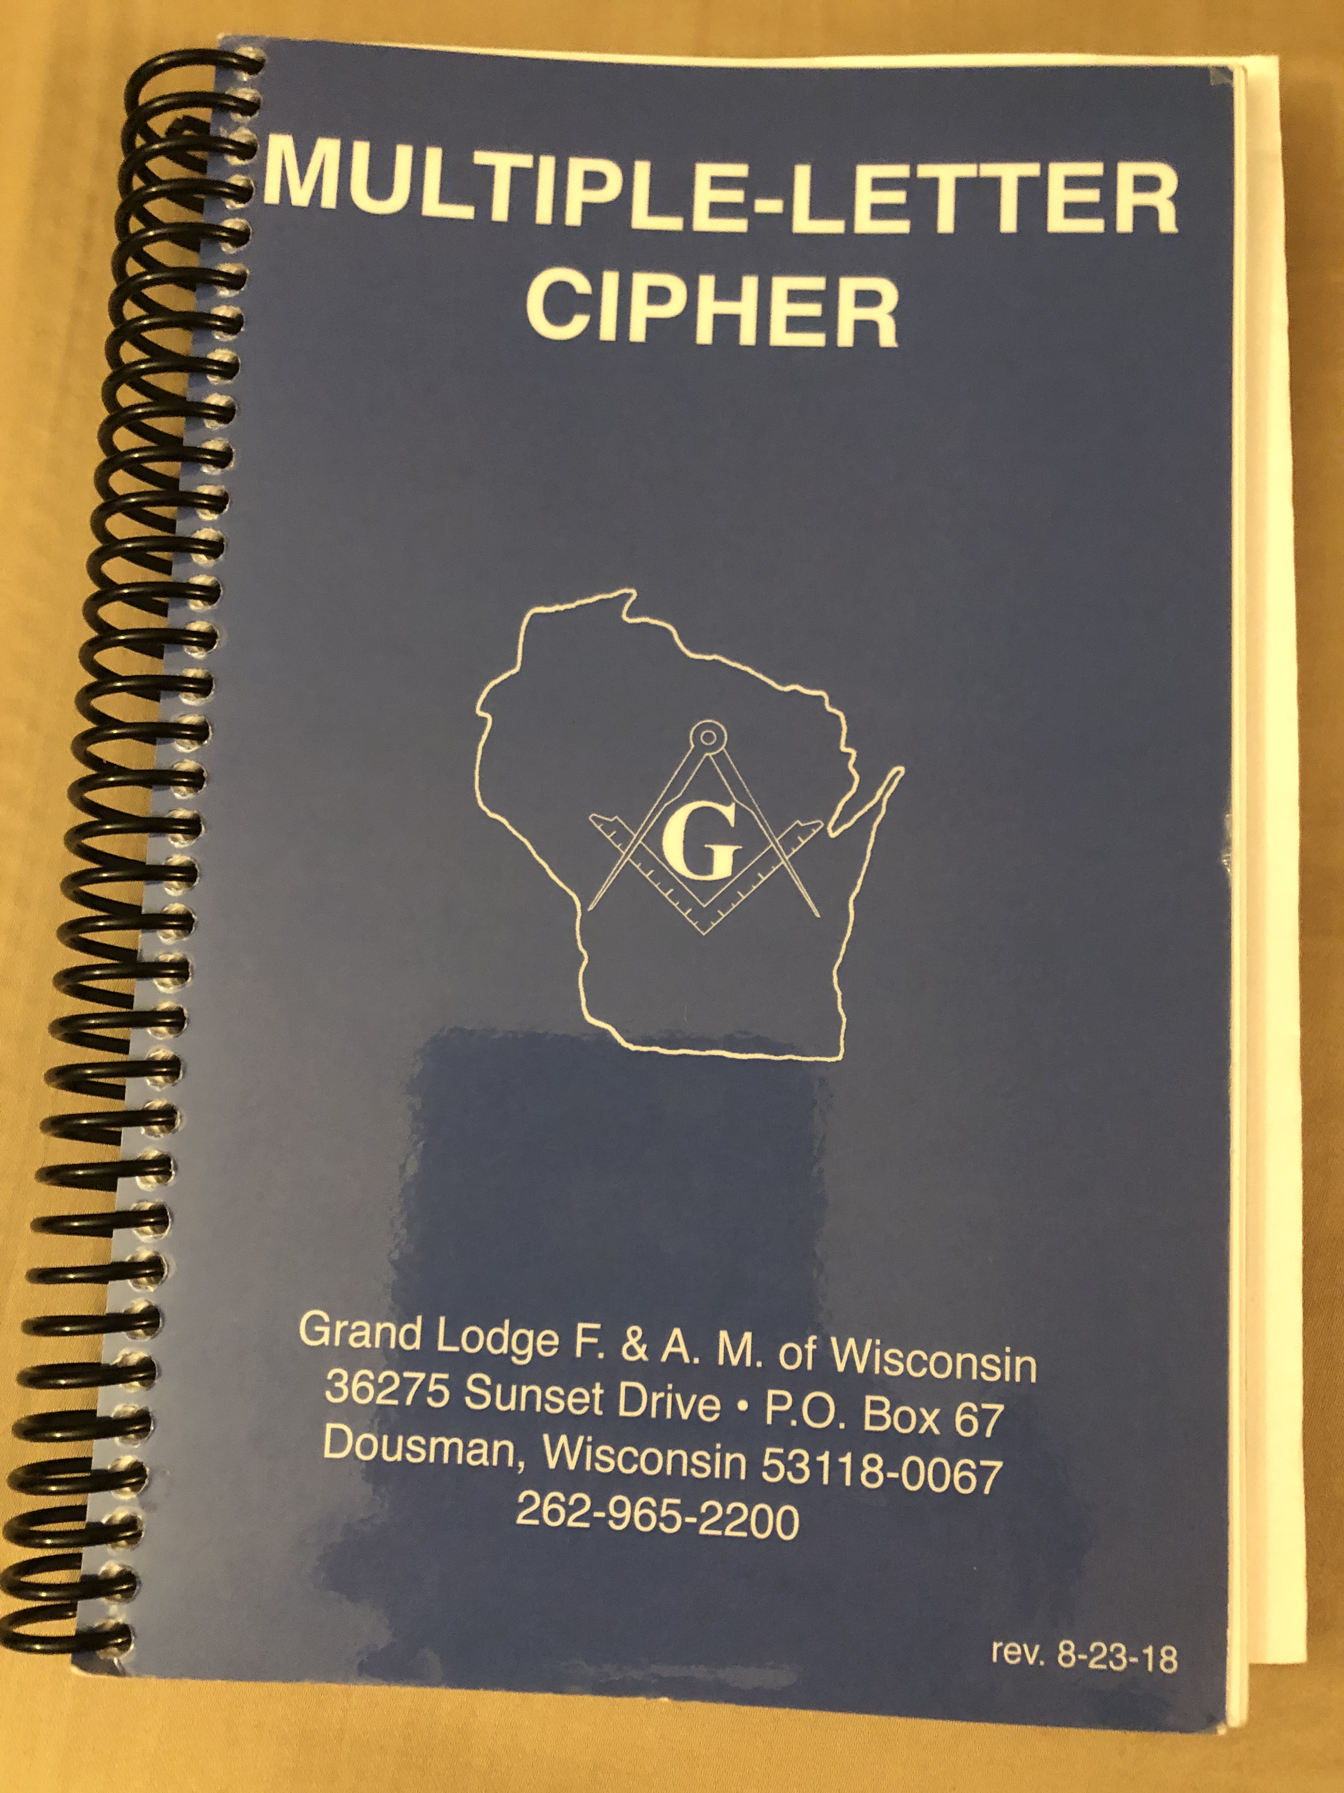
District Lecturer

Slide 14
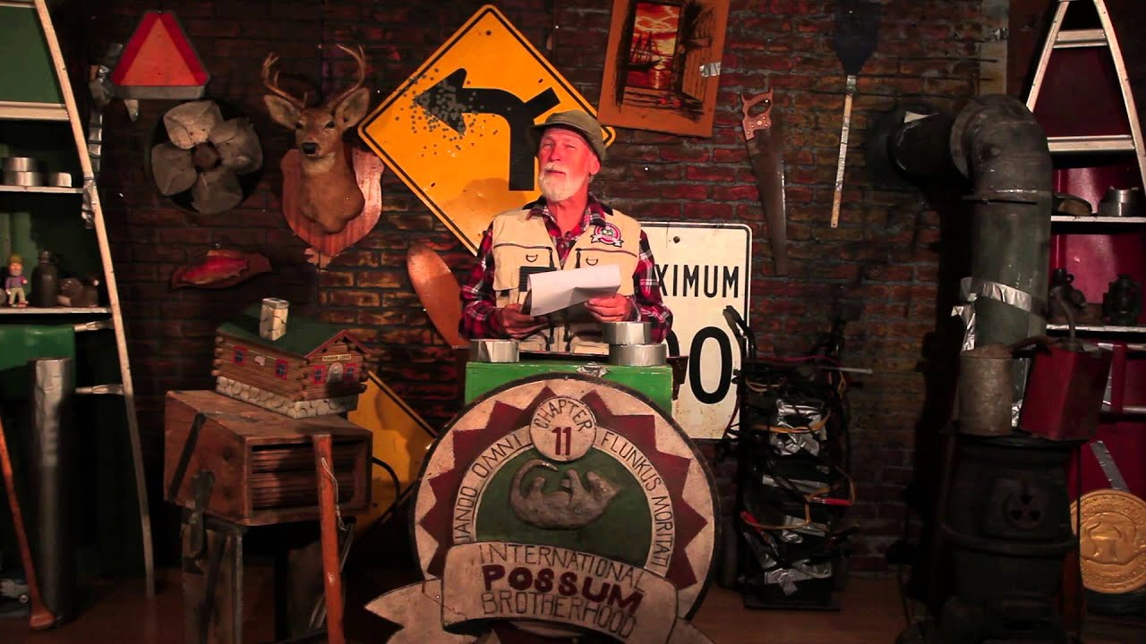
The Lodge

Slide 15
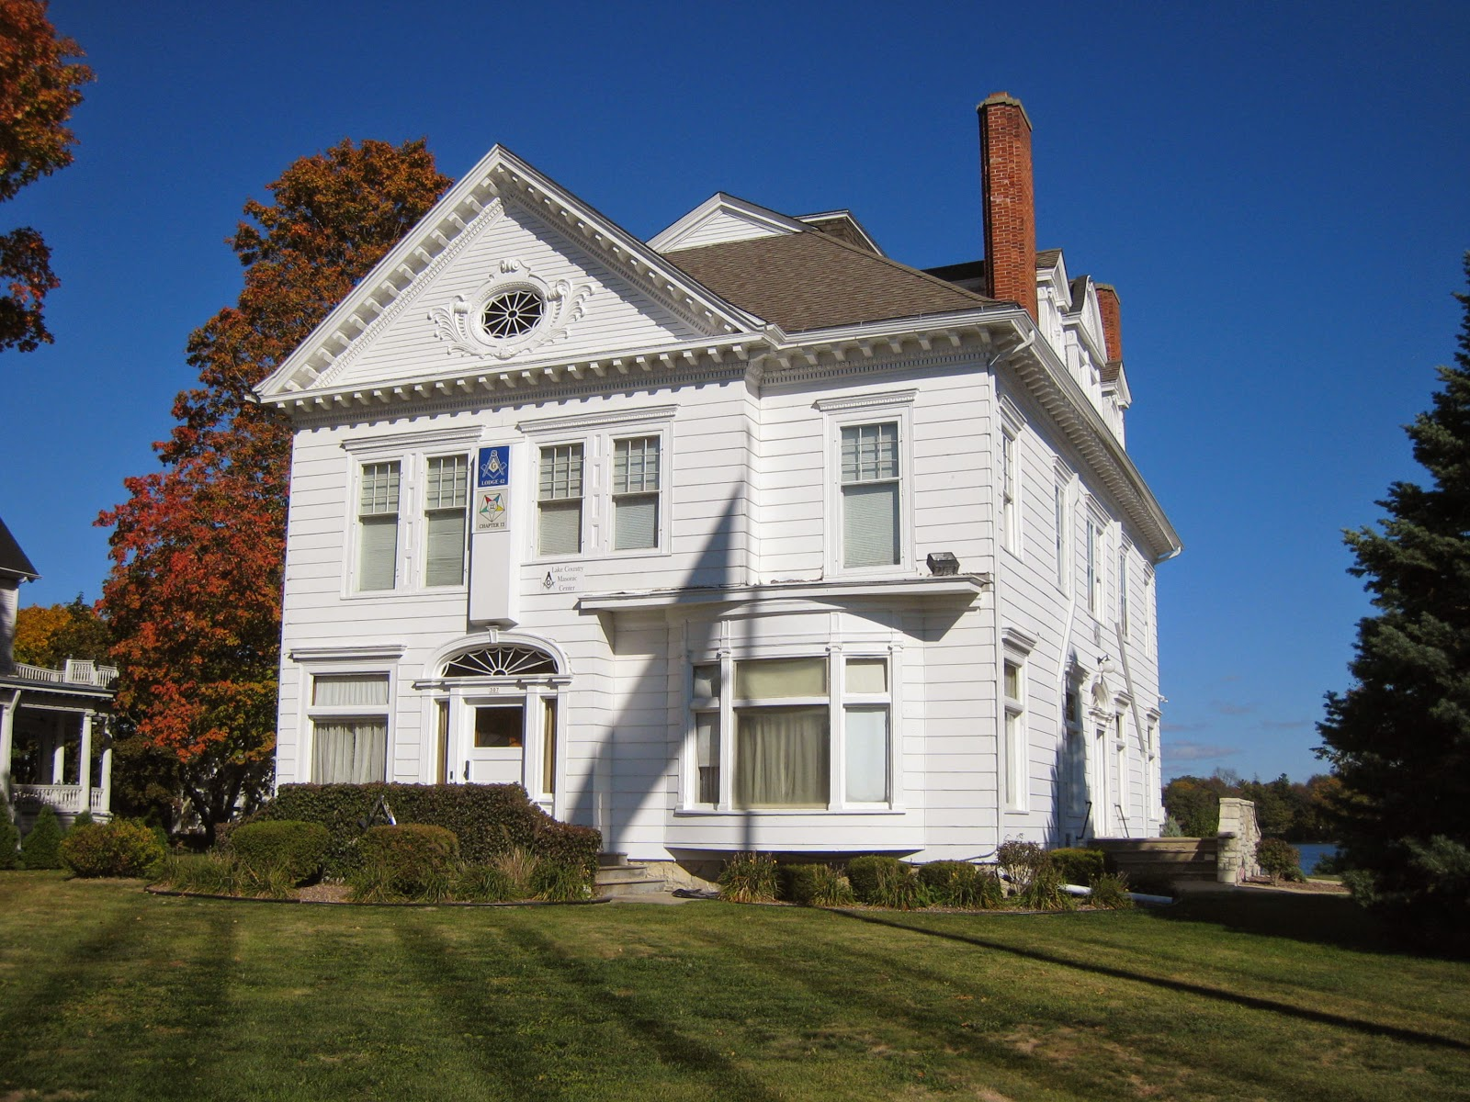
The Lodge

Slide 16
Lodge Officers
Tres.
WM
Sec.
SD
Chap
SS
Altar
JW
JS
Coun.
JD
SW
Tiler

Slide 17
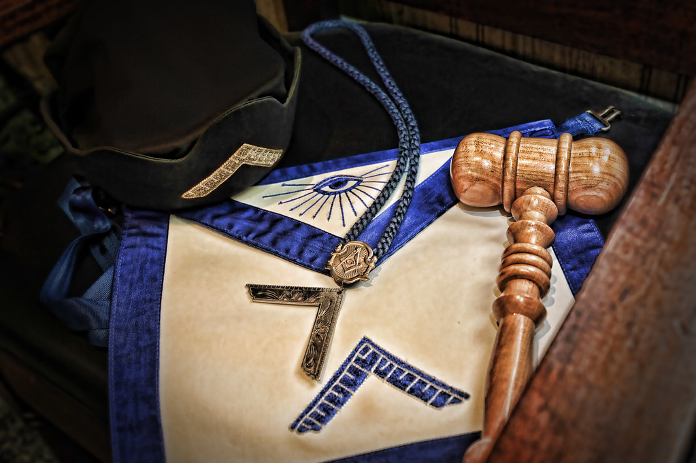
Worshipful Master
Tres.
WM
Sec.
SD
Chap
SS
Altar
JW
JS
Coun.
JD
SW
Tiler

Slide 18
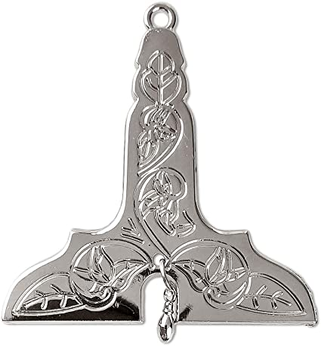
Senior Warden
Tres.
WM
Sec.
SD
Chap
SS
Altar
JW
JS
Coun.
JD
SW
Tiler

Slide 19
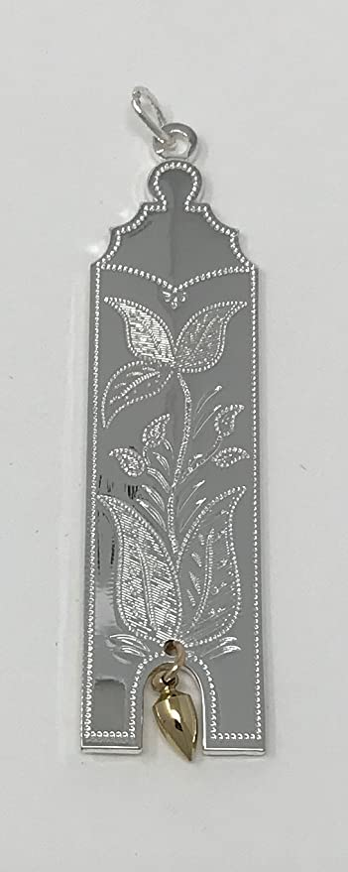
Junior Warden
Tres.
WM
Sec.
SD
Chap
SS
Altar
JW
JS
Coun.
JD
SW
Tiler

Slide 20
Secretary
Tres.
WM
Sec.
SD
Chap
SS
Altar
JW
JS
Coun.
JD
SW
Tiler

Slide 21
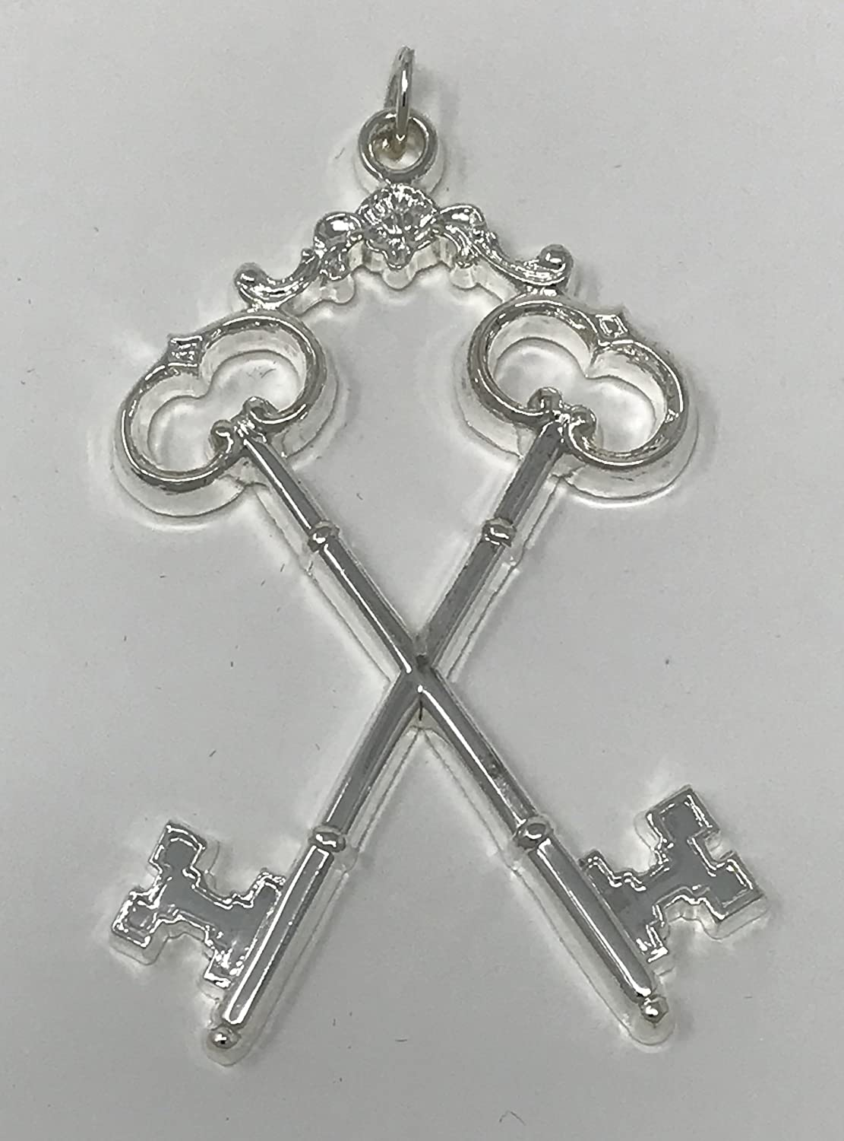
Treasurer
Tres.
WM
Sec.
SD
Chap
SS
Altar
JW
JS
Coun.
JD
SW
Tiler

Slide 22
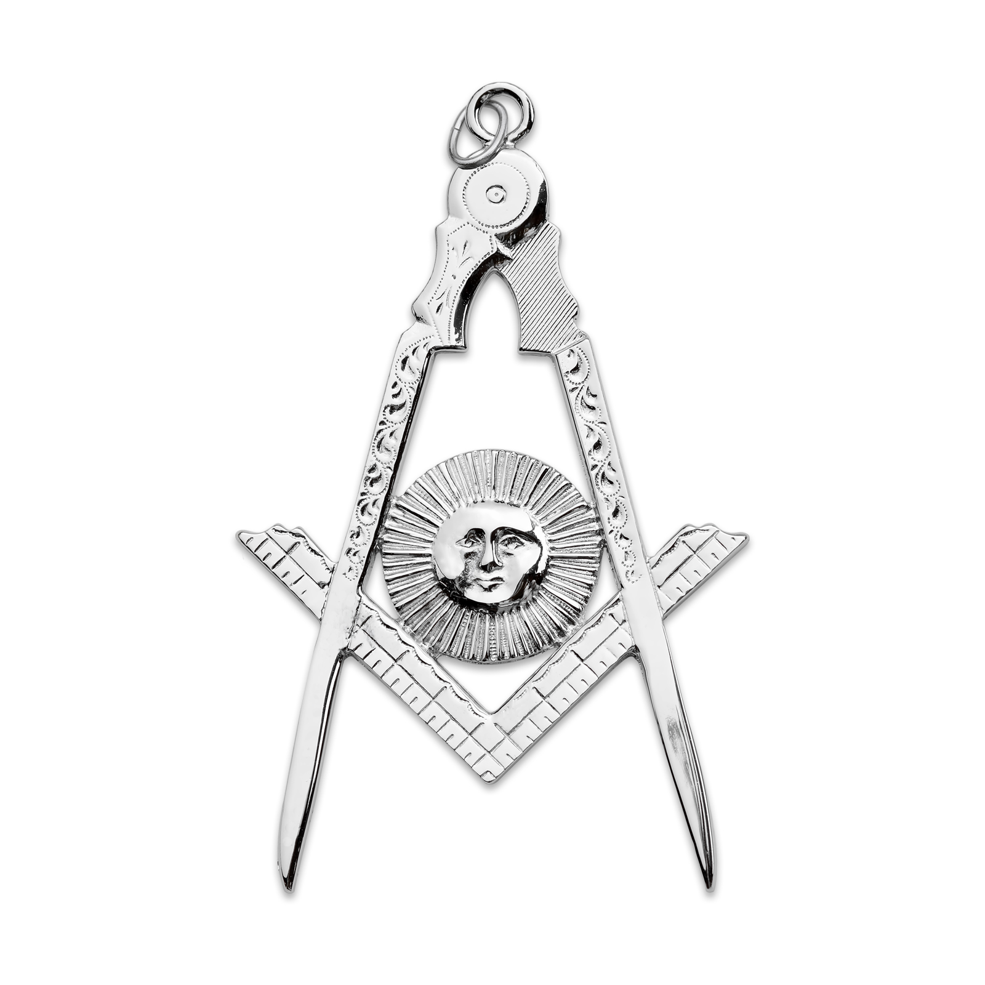
Senior & Junior Deacons
Tres.
WM
Sec.
SD
Chap
SS
Altar
JW
JS
Coun.
JD
SW
Tiler

Slide 23
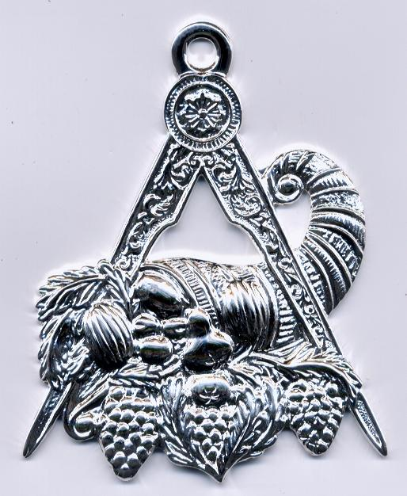
Senior & Junior Stewards
Tres.
WM
Sec.
SD
Chap
SS
Altar
JW
JS
Coun.
JD
SW
Tiler

Slide 24
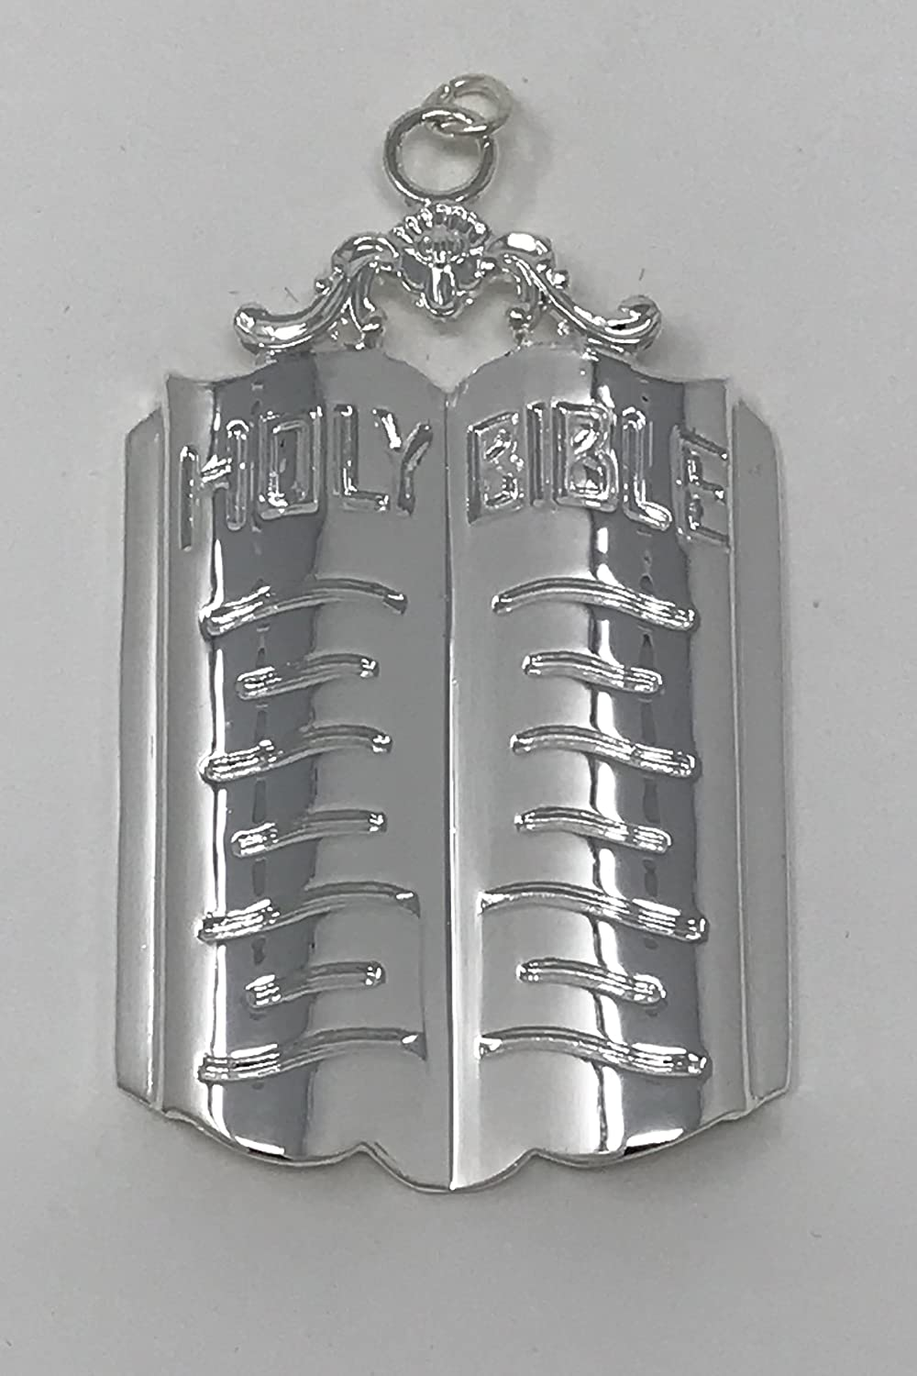
Chaplain
Tres.
WM
Sec.
SD
Chap
SS
Altar
JW
JS
Coun.
JD
SW
Tiler

Slide 25
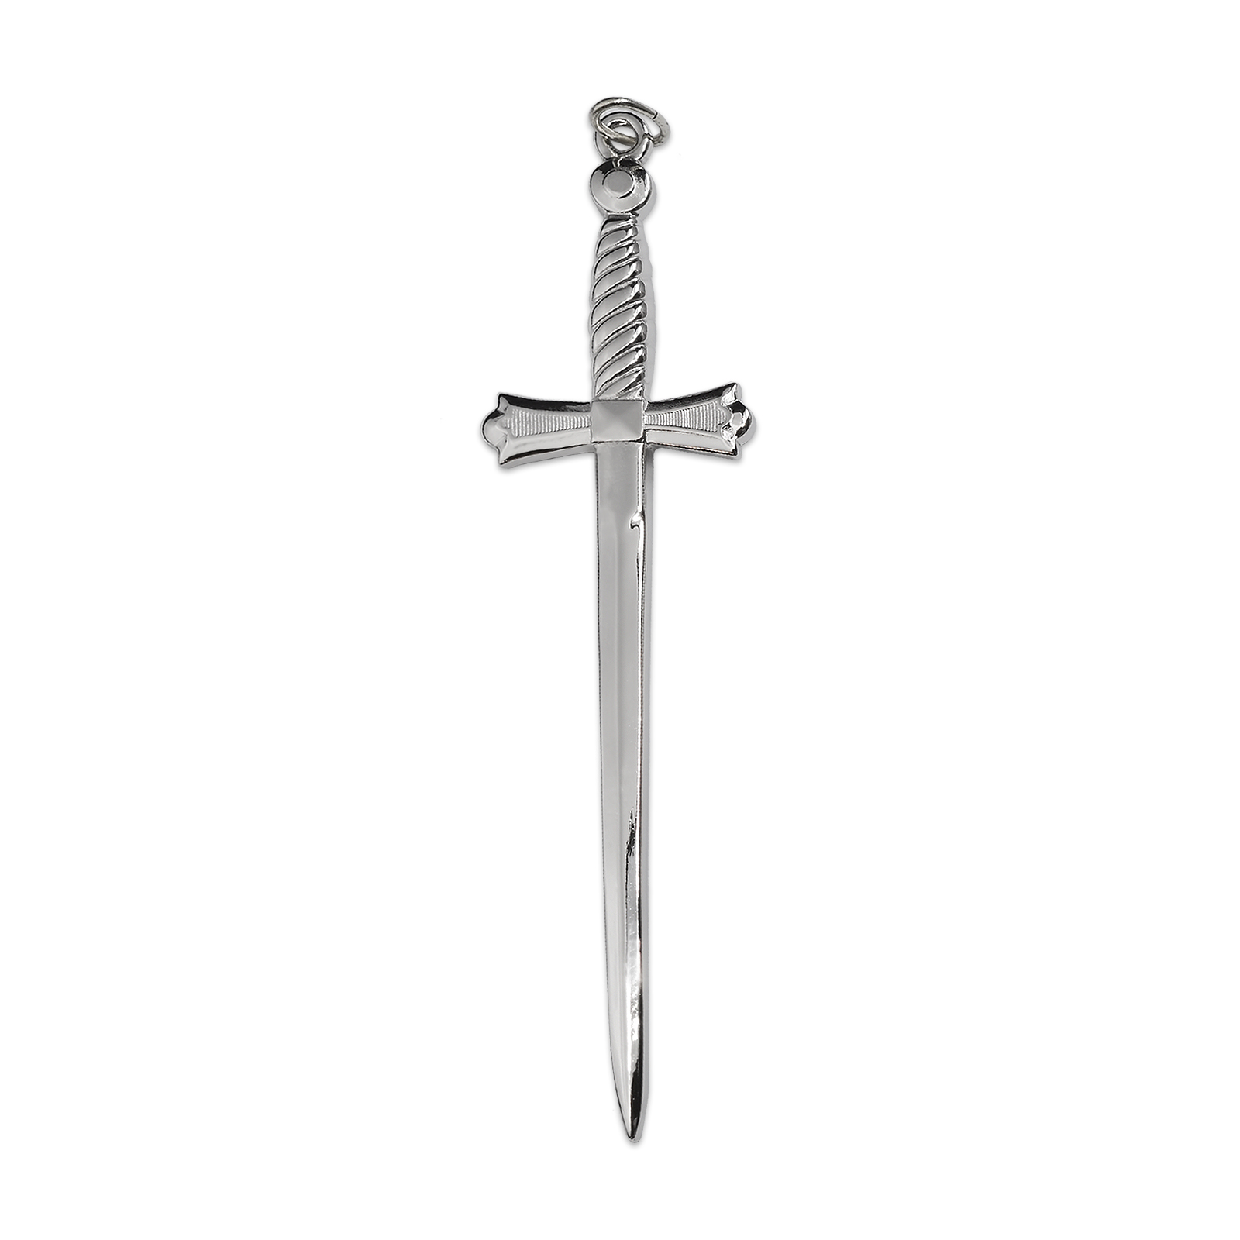
Tiler
Tres.
WM
Sec.
SD
Chap
SS
Altar
JW
JS
Coun.
JD
SW
Tiler

Slide 26
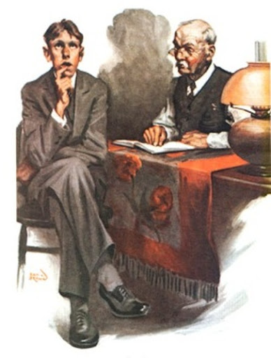
Counselor
Tres.
WM
Sec.
SD
Chap
SS
Altar
JW
JS
Coun.
JD
SW
Tiler

Slide 27
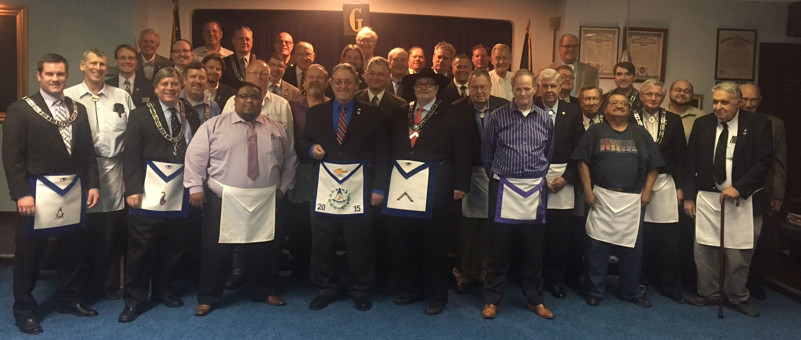
Always on the Level

